Slide 1
Encryption
What it is, what it isn’t, what it’s used for, and how to use it.

Slide 2
What is encryption?
Encryption is the method of converting any type of information/data into an unreadable format to prevent unauthorized access to data.

Slide 3
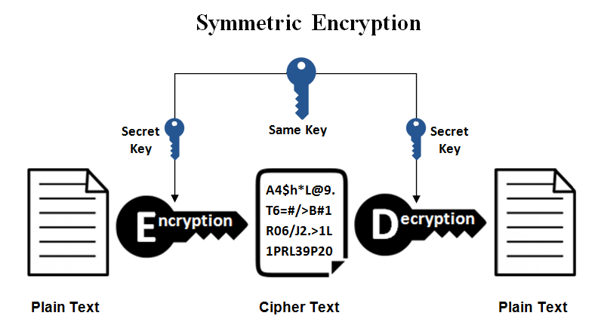
How does it work?
Many methods of encryption use a cipher to manipulate data, by using a “key” or “password” to transform the data both ways. This is called “symmetric” encryption.

Slide 4
What are some popular methods of symmetric encryption?
AES
DES/TripleDES (DES is weak and replaced by 3DES)
Blowfish
XOR

Slide 5
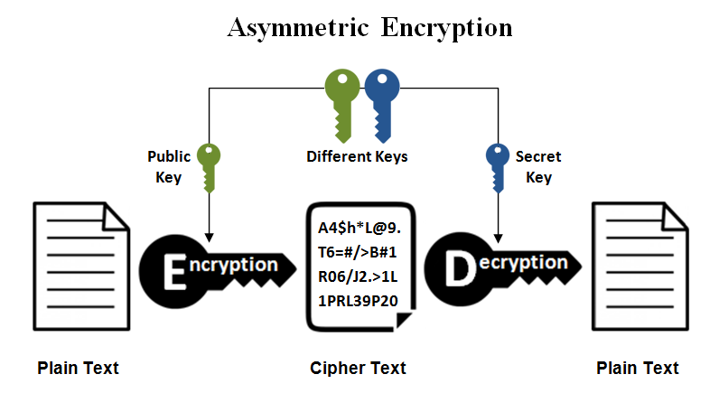
Other other types of encryption use a special cipher that uses two types of keys, one public (to encrypt) and private (to decrypt) to transform the data.

Slide 6
What are some popular methods of asymmetric encryption?
RSA (PKCS#1)
Diffie-Hellman (used in symmetric key exchange)
DSA
Elliptic Curve

Slide 7
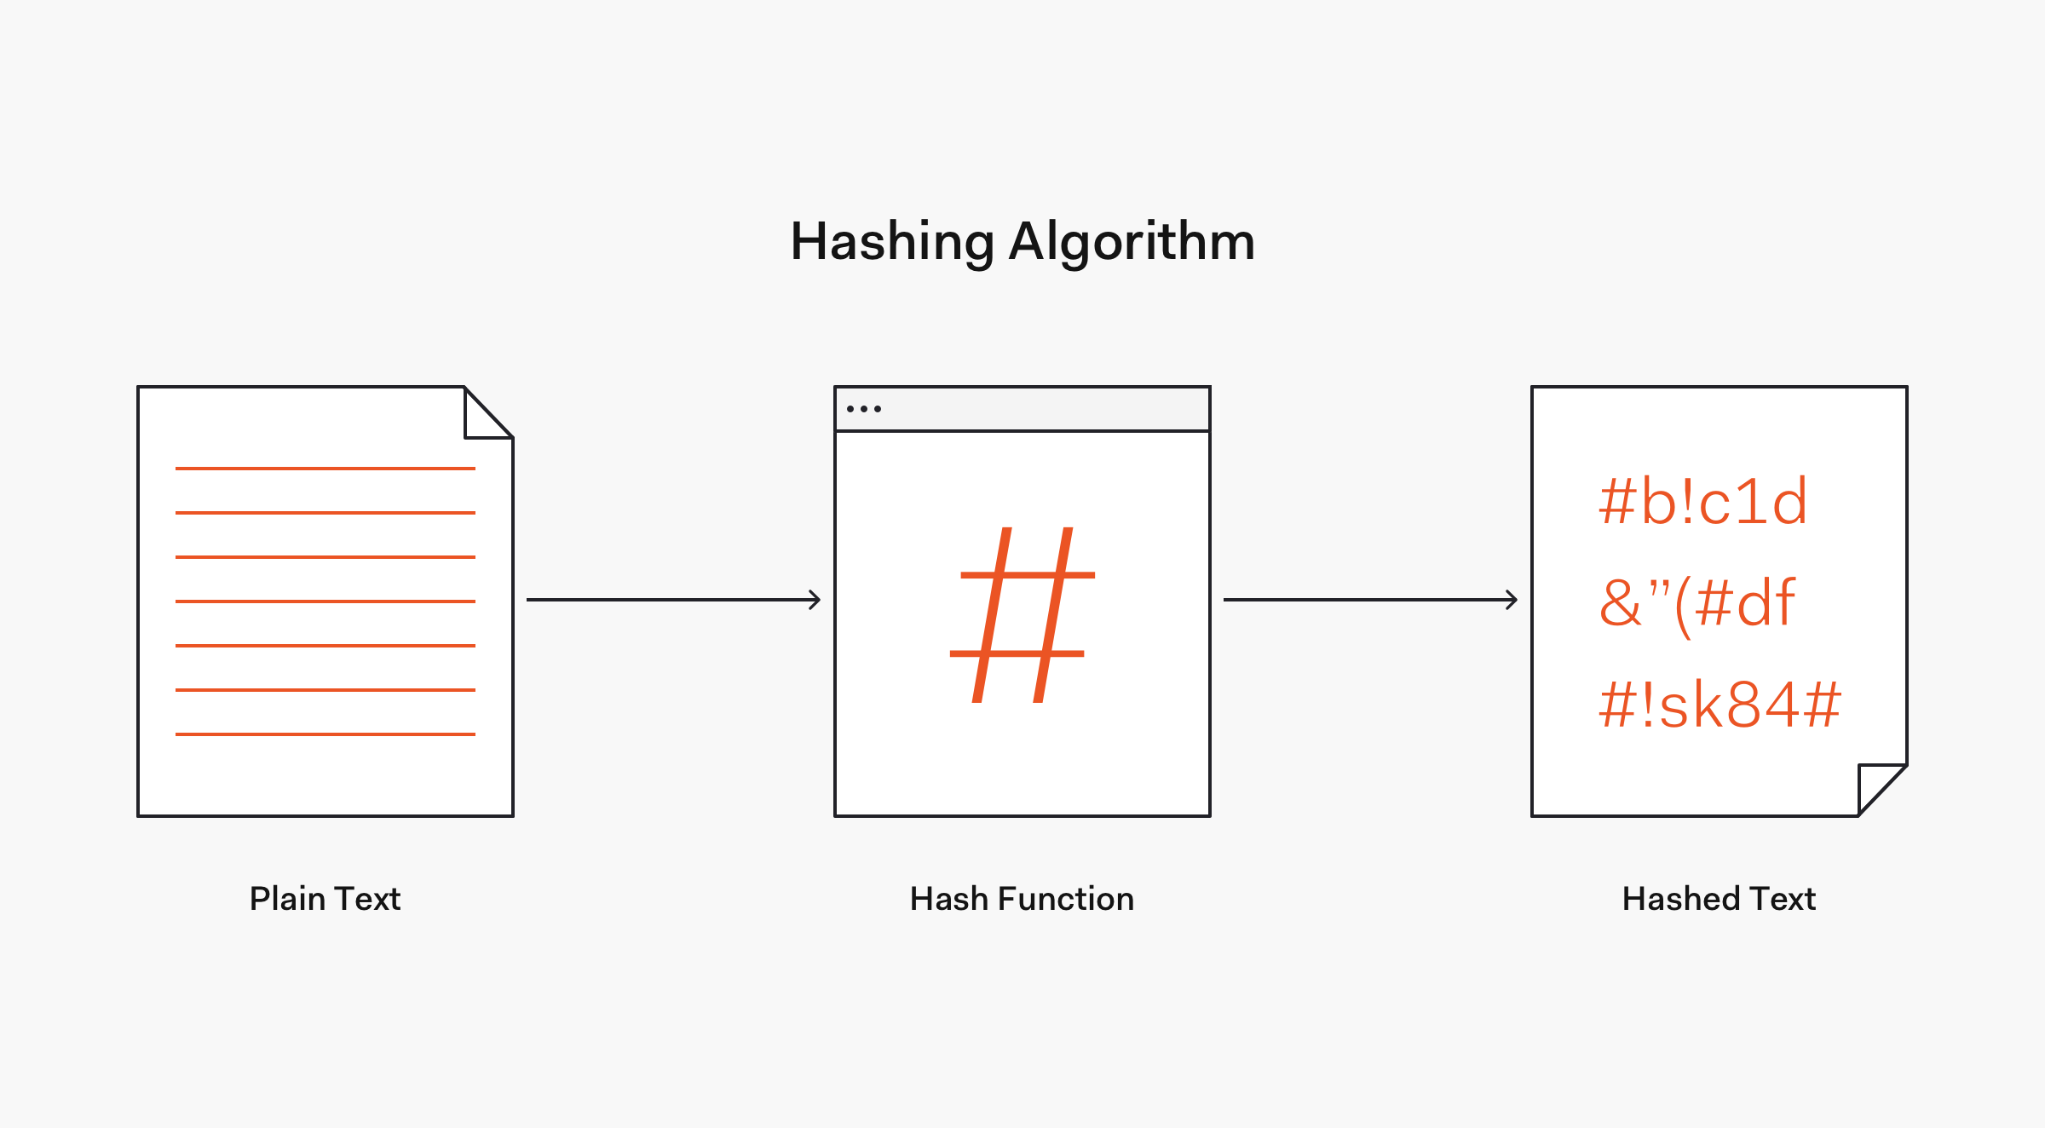
There’s also a type of encryption called "hashing" that is irreversible.

Slide 8
What are some popular methods of hashing?
MD5 (insecure, collisions found)
SHA-1 (insecure, collisions found)
SHA-256
SHA-384
SHA-512
HMAC

Slide 9
Why do we need encryption in a modern world?
It’s more secure than a post-it note on a monitor.
It prevents unauthorized parties from accessing data.
It can keep information safe and secure.
Plenty more reasons...

Slide 10
SSL (Secure Sockets Layer)
A way to establish an encrypted connection between server and client.
Useful to prevent traffic sniffing and man in the middle attacks.

Slide 11
TLS (Transport Layer Security)
The successor to SSL.
More secure, by utilizing better ciphers and key exchange algorithms.
Exploits in implementations (for both SSL and TLS)
Heartbleed

Slide 12
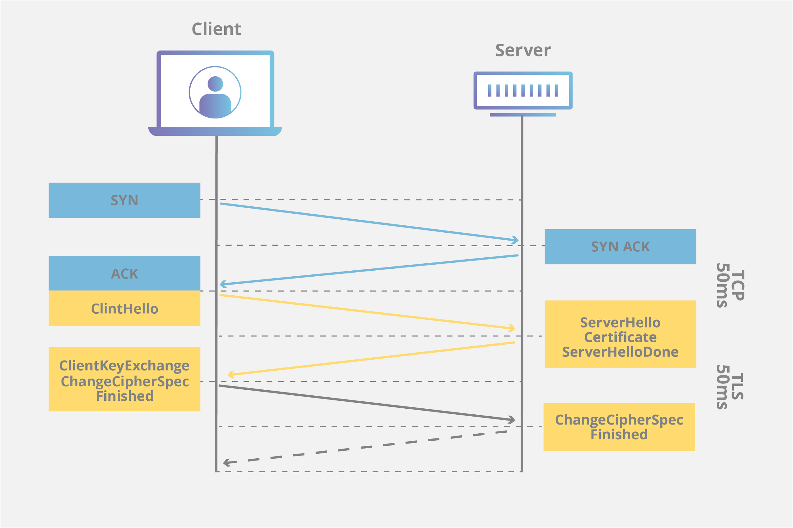
How does it work?

Slide 13
What is a “SSL certificate”?
Not actually “SSL” certificates, this is a common misconception.
Provides a public/private key that has been signed by a trusted entity.
Used in web servers, such as nginx or apache, to initiate SSL/TLS connections to any connecting clients, and to validate ownership of a domain.
We can validate that keys used are valid for said domain.

Slide 14
How can we use SSL certificates with TLS compatibility?
SSL certificates are not dependent on protocols.

Slide 15
What are some popular reasons to use encryption in code?
To maintain data integrity by preventing modification of files and or data used by software.
Protecting configuration files.
Protecting any private data (i.e customer data, business logic, etc).

Slide 16
Resources to learn more about encryption
https://github.com/sobolevn/awesome-cryptography

